Slide 1
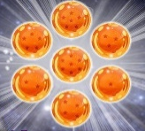

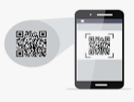
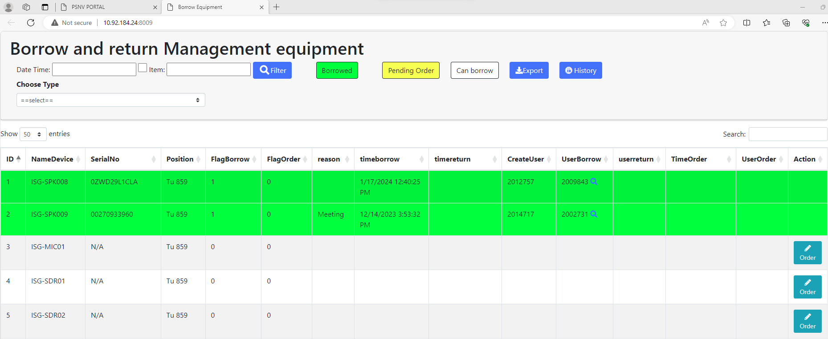
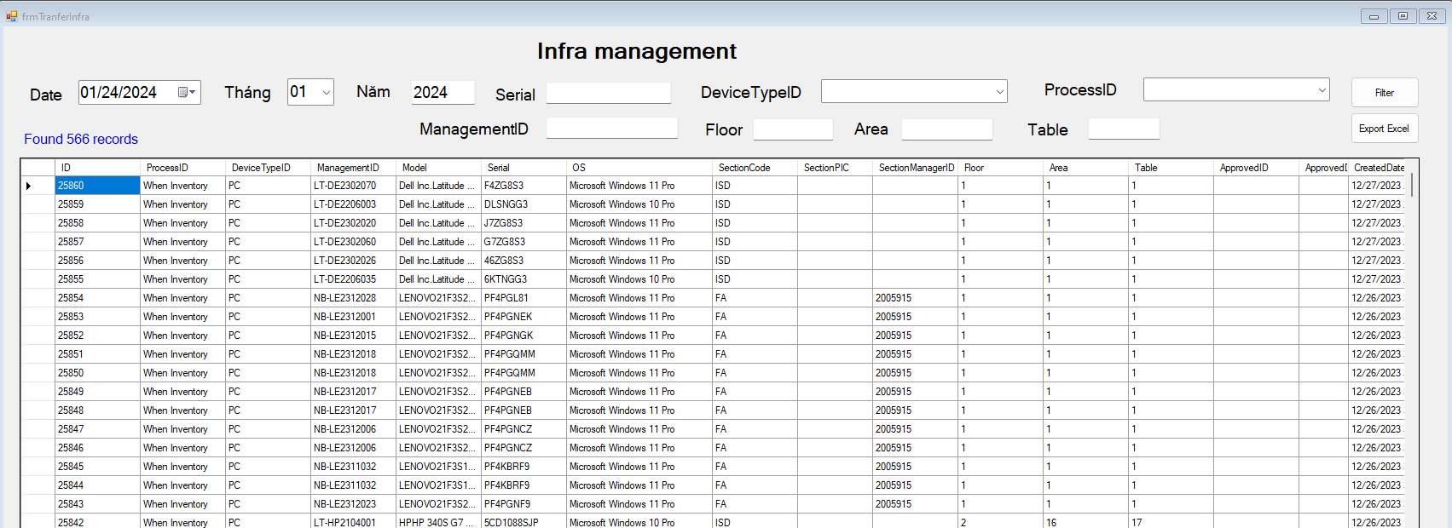
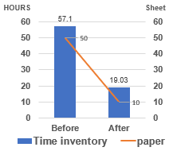
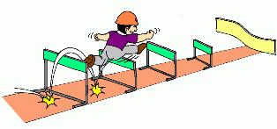
Effect Confirmation
15/18
VISIBLE EFFECT
INVISIBLE EFFECT
BEFORE QCC
software
Visualize
Auto Report
2.8
AFTER QCC
Database
3.8
Result
NEGATIVE AND SOLUTION
1
Negative
Members do not understand each other.
Solution
Analyze deeply problem, make clear all process.
QCC
Future
Forward
2
Negative
Difficulty dividing work.
Solution
Based on each person's strengths to divide.
Notes:
He thong duoc truc quan hoa cac thao tac, tu dong auto make report
Ve hieu qua hoat dong nhom chung toi da dat muc tieu de ra la 3.8
Mot so kho khan trong qua trinh hoat dong nhom nhu:
+ cac thanh vien khong hieu y nhau: -> phan tich ky va make clear all quy trinh
+ kho phan chia cong viec -> dua vao diem manh tung nguoi va phan chia dung cong viec

Slide 2
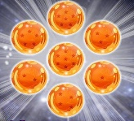




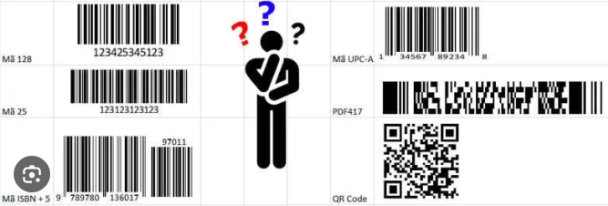

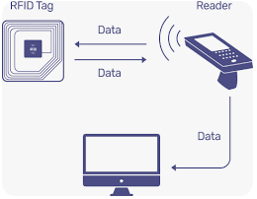
Analysis Main Cause (1)
8/18
Borrow & Return Equipment process
Borrow
Borrow
Return
Return
IT
Record papers
User
Analysis process
Main cause
User borrow & Return equipment
❶
A lot of manual Job, waste papers
Not unique to identify equipment
No software to manage
Next
IT member record information by paper
❷
IT member check manual inventory
❸
Make report monthly
❹
Notes:
Muon tra thiet bi.
Deu duoc thuc hien bang viec ghi chep tren so sach
Tai sao chung ta khong nghi ve giai phap su dung cong nghe barcode hay 1 cong cu khac de quan ly?

